Slide 1
Ethics in Information Technology, Fourth Edition
Chapter 4
Privacy
Notes:
‹#›

Slide 2
Objectives
As you read this chapter, consider the following questions:
What is the right of privacy, and what is the basis for protecting personal privacy under the law?
What are some of the laws that provide protection for the privacy of personal data, and what are some of the associated ethical issues?
What is identity theft, and what techniques do identity thieves use?
Ethics in Information Technology, Fourth Edition
Notes:
‹#›

Slide 3
Objectives (cont’d.)
What are the various strategies for consumer profiling, and what are the associated ethical issues?
What must organizations do to treat consumer data responsibly?
Why and how are employers increasingly using workplace monitoring?
What are the capabilities of advanced surveillance technologies, and what ethical issues do they raise?
Ethics in Information Technology, Fourth Edition
Notes:
‹#›

Slide 4
Privacy Protection and the Law
Systems collect and store key data from every interaction with customers to make better decisions
Approve of a loan, hire a job candidate etc
global marketplace and intensified competition have increased the importance of knowing consumers’ purchasing habits and financial condition.
Companies use this information to target marketing efforts to consumers who are most likely to buy their products and services
Organizations also need basic information about customers to serve them better
Ethics in Information Technology, Fourth Edition
Notes:
‹#›

Slide 5
Privacy Protection and the Law
Many object to data collection policies of government and business
Privacy
Key concern of Internet users
Top reason why nonusers still avoid the Internet
Reasonable limits must be set (business and gov)
Combination of approaches required
New laws – technical solutions – privacy policies
Ethics in Information Technology, Fourth Edition
Notes:
‹#›

Slide 6
Privacy Protection and the Law
Historical perspective on the right to privacy
Questions on constitution – strong government would intrude the privacy of citizens
Fourth Amendment reasonable expectation of privacy
No expectation of privacy – no privacy right
Privacy protection from private industry
Few laws provide this protection
Ethics in Information Technology, Fourth Edition
Notes:
‹#›

Slide 7
Information Privacy
Definition of privacy
“The right to be left alone—the most comprehensive of rights, and the right most valued by a free people”
Information privacy is a combination of:
Communications privacy
Ability to communicate with others without being monitored by other persons or organizations
Data privacy
Ability to limit access to one’s personal data by other individuals and organizations in order to exercise a substantial degree of control over that data and its use
Ethics in Information Technology, Fourth Edition
Notes:
‹#›

Slide 8
Privacy Laws, Applications, and Court Rulings
Legislative acts passed over the past 40 years
Most address invasion of privacy by the government
No protection of data privacy abuses by corporations
No single, overarching national data privacy policy
No established advisory agency that recommends acceptable privacy practices to businesses
Ethics in Information Technology, Fourth Edition
Notes:
‹#›

Slide 9
Privacy Laws, Applications, and Court Rulings (cont’d.)
Financial data
Individuals must reveal much of their personal financial data in order to take advantage of the wide range of financial products and services available, including credit cards, checking and savings accounts, loans, payroll direct deposit
To access many of these financial products and services, individuals must use a personal logon name, password, account number, or PIN
Loss of this data – loss of privacy and financial loss
Users concerned how this data is protected
Ethics in Information Technology, Fourth Edition

Slide 10
Privacy Laws, Applications, and Court Rulings (cont’d.)
Financial data
Fair Credit Reporting Act (1970)
Regulates operations of credit-reporting bureaus
Fair and Accurate Credit Transactions Act (2003)
Allows consumers to request and obtain a free credit report once each year from each of the three primary consumer credit reporting companies
Right to Financial Privacy Act (1978)
Protects the financial records of financial institution customers from unauthorized scrutiny by the federal government
Ethics in Information Technology, Fourth Edition

Slide 11
Privacy Laws, Applications, and Court Rulings (cont’d.)
Financial data (cont’d.)
Gramm-Leach-Bliley Act (1999)
Bank deregulation that enabled institutions to offer investment, commercial banking, and insurance services
Three key rules affecting personal privacy
Financial Privacy Rule – opt-in and opt-out
Safeguards Rule – document data security/protection plan for customer data
Pretexting Rule – access personal information without proper authority
Ethics in Information Technology, Fourth Edition

Slide 12
Privacy Laws, Applications, and Court Rulings (cont’d.)
Financial data (cont’d.)
Gramm-Leach-Bliley Act (1999)
Financial Privacy Rule – opt-in and opt-out
OPT-OUT
Under this provision, must provide privacy notice
Must also explain customer’s right to opt-out to refuse to give right to collect and share personal data
Inform when privacy policy is changed
At the time of relationship and each year afterwards
OPT- IN
Customers take no action, automatically opt-in and give right to share personal data
Ethics in Information Technology, Fourth Edition

Slide 13
Privacy Laws, Applications, and Court Rulings (cont’d.)
Health information
The use of electronic medical records and the subsequent interlinking and transferring of this electronic information among different organizations has become widespread
They fear intrusions into their health data by employers, schools, insurance firms, law enforcement agencies, and even marketing firms looking to promote their products and services
Ethics in Information Technology, Fourth Edition
Notes:
‹#›

Slide 14
Privacy Laws, Applications, and Court Rulings (cont’d.)
Health information
Health Insurance Portability and Accountability Act (1996)
Improves the portability and continuity of health insurance coverage
Reduces fraud, waste, and abuse
Simplifies the administration of health insurance
American Recovery and Reinvestment Act (2009)
Included strong privacy provisions for electronic health records
Offers protection for victims of data breaches
Ethics in Information Technology, Fourth Edition
Notes:
‹#›

Slide 15
Privacy Laws, Applications, and Court Rulings (cont’d.)
State laws related to security breach notification
Over 40 states have enacted legislation requiring organizations to disclose security breaches
For some states, these laws are quite stringent
Ethics in Information Technology, Fourth Edition

Slide 16
Privacy Laws, Applications, and Court Rulings (cont’d.)
Children’s personal data
Children’s Online Privacy Protection Act (1998)
Web sites catering to children must offer comprehensive privacy policies, notify parents or guardians about its data-collection practices, and receive parental consent before collecting personal information from children under 13
Family Education Rights and Privacy Act (1974)
Assigns rights to parents regarding their children’s education records
Rights transfer to student once student becomes 18
Ethics in Information Technology, Fourth Edition

Slide 17
Privacy Laws, Applications, and Court Rulings (cont’d.)
Electronic surveillance
This section covers laws that address government surveillance, including various forms of electronic surveillance.
New laws have been added and old laws amended in recent years in reaction to worldwide terrorist activities and the development of new communication technologies.
Ethics in Information Technology, Fourth Edition

Slide 18
Privacy Laws, Applications, and Court Rulings (cont’d.)
Electronic surveillance
Communications Act of 1934
Established the Federal Communications Commission
Regulates all non-federal-government use of radio and television plus all interstate communications
Title III of the Omnibus Crime Control and Safe Streets Act (Wiretap Act)
Regulates interception of telephone and oral communications
Has been amended by new laws
Ethics in Information Technology, Fourth Edition

Slide 19
Privacy Laws, Applications, and Court Rulings (cont’d.)
Electronic surveillance (cont’d.)
Foreign Intelligence Surveillance Act (FISA) of 1978
Describes procedures for electronic surveillance and collection of foreign intelligence information in communications between foreign powers and agents of foreign powers
Ethics in Information Technology, Fourth Edition

Slide 20
Privacy Laws, Applications, and Court Rulings (cont’d.)
Electronic surveillance (cont’d.)
Electronic Communications Privacy Act of 1986 (ECPA)
Protects communications in transfer from sender to receiver
Protects communications held in electronic storage
Prohibits recording dialing, routing, addressing, and signaling information without a search warrant
Pen register records electronic impulses to identify numbers dialed for outgoing calls
Trap and trace records originating number of incoming calls
Ethics in Information Technology, Fourth Edition

Slide 21
Privacy Laws, Applications, and Court Rulings (cont’d.)
Electronic surveillance (cont’d.)
Communications Assistance for Law Enforcement Act (CALEA) 1994
Amended both the Wiretap Act and ECPA
Required the telecommunications industry to build tools into its products so federal investigators could eavesdrop and intercept electronic communications
Covered emerging technologies, such as:
Wireless modems
Radio-based electronic mail
Cellular data networks
Ethics in Information Technology, Fourth Edition

Slide 22
Privacy Laws, Applications, and Court Rulings (cont’d.)
Electronic surveillance (cont’d.)
USA PATRIOT Act (2001)
Increased ability of law enforcement agencies to search telephone, email, medical, financial, and other records
Critics argue law removed many checks and balances that ensured law enforcement did not abuse its powers
Relaxed requirements for National Security Letters (NSLs)
Ethics in Information Technology, Fourth Edition

Slide 23
Privacy Laws, Applications, and Court Rulings (cont’d.)
Export of personal data
Various organizations have developed guidelines to ensure that the flow of personal data across national boundaries (transborder data flow) does not result in the unlawful storage of personal data, the storage of inaccurate personal data, or the abuse or unauthorized disclosure of such data
Ethics in Information Technology, Fourth Edition

Slide 24
Privacy Laws, Applications, and Court Rulings (cont’d.)
Export of personal data
Organisation for Economic Co-operation and Development Fair Information Practices (1980)
Fair Information Practices
Set of eight principles
Model of ethical treatment of consumer data
Ethics in Information Technology, Fourth Edition

Slide 25
Privacy Laws, Applications, and Court Rulings (cont’d.)
Export of personal data (cont’d.)
European Union Data Protection Directive
Requires companies doing business within the borders of 15 European nations to implement a set of privacy directives on the fair and appropriate use of information
Goal to ensure data transferred to non-European countries is protected
Based on set of seven principles for data privacy
Concern that U.S. government can invoke USA PATRIOT Act to access data
Ethics in Information Technology, Fourth Edition

Slide 26
Privacy Laws, Applications, and Court Rulings (cont’d.)
Access to government records
The government has a great capacity to store data about each and every one of us and about the proceedings of its various organizations
The Freedom of Information Act enables the public to gain access to certain government records, and the Privacy Act prohibits the government from concealing the existence of any personal data record-keeping systems
Ethics in Information Technology, Fourth Edition

Slide 27
Privacy Laws, Applications, and Court Rulings (cont’d.)
Access to government records (cont’d.)
The Privacy Act of 1974
Prohibits government agencies from concealing the existence of any personal data record-keeping system
Outlines 12 requirements that each record-keeping agency must meet
CIA and law enforcement agencies are excluded from this act
Does not cover actions of private industry
Ethics in Information Technology, Fourth Edition

Slide 28
Local Scenario
In the existing legal framework of Pakistan, the right to privacy falls under Article 14 (1) of the Constitution, which states that the “dignity of man, and subject to law, the privacy of home, shall be inviolable”
Only one section of the Electronic Transaction Ordinance, 2002, Article 43 (2) (e) recommends that the federal government may make regulations to provide for “privacy and protection of data of subscribers” but these are yet to be made.
The Prevention of Electronic Crimes Act, 2016, provides for telecom and internet service providers to retain data for at least 90 days, but does not include any provisions that protect citizen’s data or privacy.
privacy commission still does not exist, though the IT ministry is on record saying that a draft data protection law is under way
Ethics in Information Technology, Fourth Edition

Slide 29
International Scenario
The British government recently introduced a new draft data protection bill which will replace the 1998 law
the bill proposes tougher penalties on companies for data breaches, as well as a requirement by businesses to inform the UK information commissioner’s office about any breach within 72 hours
Ethics in Information Technology, Fourth Edition

Slide 30
Key Privacy and Anonymity Issues
Identity theft
Electronic discovery
Consumer profiling
Treating customer data responsibly
Workplace monitoring
Advanced surveillance technology
Ethics in Information Technology, Fourth Edition
Notes:
‹#›

Slide 31
Identity Theft
Theft of key pieces of personal information to impersonate a person, including:
Name
Address
Date of birth
Social Security number
Passport number
Driver’s license number
Mother’s maiden name
thief may apply for new credit or financial accounts, rent an apartment, set up utility or phone service, and register for college courses
Ethics in Information Technology, Fourth Edition
Notes:
‹#›

Slide 32
Identity Theft (cont’d.)
Fastest-growing form of fraud in the United States
Consumers and organizations are becoming more vigilant and proactive in fighting identity theft
Credit monitoring service
Recognize obvious phishing attempts
Improved system and practices
Ethics in Information Technology, Fourth Edition
Notes:
‹#›

Slide 33
Identity Theft (cont’d.)
Four approaches used by identity thieves
Create a data breach
Purchase personal data
Use phishing to entice users to give up data
Install spyware to capture keystrokes of victims
Ethics in Information Technology, Fourth Edition
Notes:
‹#›

Slide 34
Identity Theft (cont’d.)
Recommendations for safeguarding your identity data
Completely and irrevocably destroy digital identity data on used equipment
Shred everything
Require retailers to request a photo ID when accepting your credit card
Beware shoulder surfing
Minimize personal data shown on checks
Minimize time that mail is in your mailbox
Do not use debit cards to pay for online purchases
Use hard-to-guess passwords and PINs
Ethics in Information Technology, Fourth Edition
Notes:
‹#›

Slide 35
Identity Theft (cont’d.)
Data breaches of large databases
To gain personal identity information
May be caused by:
Hackers
Failure to follow proper security procedures
Organizations are reluctant for data breaches
Victims need to informed – why?
Ethics in Information Technology, Fourth Edition

Slide 36
Identity Theft (cont’d.)
Data breach
There is no federal law requiring that organizations reveal a data breach. The state of California passed a data security breach notification law in 2002. It was enacted when the state’s payroll database was breached and victims were not notified for six weeks. The law requires that “the disclosure shall be in the most expedient time possible and without unreasonable delay, consistent with the legitimate needs of law enforcement
Ethics in Information Technology, Fourth Edition

Slide 37
Identity Theft (cont’d.)
Purchase of personal data
Black market for:
Credit card numbers in bulk—$.40 each
Logon name and PIN for bank account—$10
Identity information—including DOB, address, SSN, and telephone number—$1 to $15
Ethics in Information Technology, Fourth Edition

Slide 38
Identity Theft (cont’d.)
Phishing
Stealing personal identity data by tricking users into entering information on a counterfeit Web site
Spyware
Keystroke-logging software
Enables the capture of:
Account usernames
Passwords
Credit card numbers
Other sensitive information
Operates even if infected computer is not online
Ethics in Information Technology, Fourth Edition

Slide 39
Identity Theft (cont’d.)
Spyware
In 2007, the FBI planted spyware on the computer of a 15-year-old student in an attempt to identify him as the person responsible for sending numerous bomb threats to his high school. The FBI first obtained a warrant to allow the agency to install a program called the Computer and Internet Protocol Address Verifier on the student’s computer. The software recorded the IP addresses, dates, and times of each communication sent from the student’s computer. The student was sentenced to 90 days in juvenile detention and fined $8,852.
Ethics in Information Technology, Fourth Edition

Slide 40
Consumer Profiling
Companies openly collect personal information about Internet users
Cookies
Text files that a Web site can download to visitors’ hard drives so that it can identify visitors later
Tracking software analyzes browsing habits
Ethics in Information Technology, Fourth Edition
Notes:
‹#›

Slide 41
Consumer Profiling (cont’d.)
Four ways to limit or stop the deposit of cookies on hard drives
Set the browser to limit or stop cookies
Manually delete them from the hard drive
Download and install a cookie-management program
Use anonymous browsing programs that don’t accept cookies
Ethics in Information Technology, Fourth Edition
Notes:
‹#›

Slide 42
Consumer Profiling (cont’d.)
Personalization software
Used by marketers to optimize the number, frequency, and mixture of their ad placements
Rules-based – preferences or online behavior
Collaborative filtering - similar buying habits
Demographic filtering – demographic information
Contextual commerce-product promotions
Ethics in Information Technology, Fourth Edition
Notes:
‹#›

Slide 43
Consumer Profiling (cont’d.)
Personalization software
Rules-based – preferences or online behavior
If you use website to book airline tickets to popular vacation spot, rules based software might ensure that you are shown adds for rental cars
Collaborative filtering - similar buying habits
If you bought a book by an author, company might recommend another book by another author. Significant percentage of other customers also bought the other book
Ethics in Information Technology, Fourth Edition
Notes:
‹#›

Slide 44
Consumer Profiling (cont’d.)
Personalization software
Demographic filtering – demographic information
Microsoft has captured age, sex, and location information for years through its various Web sites, including MSN and Hotmail. It has accumulated a vast database on tens of millions of people, each assigned a global user ID. Microsoft has also developed a technology based on this database that enables marketers to target one ad to men and another to women.
Ethics in Information Technology, Fourth Edition
Notes:
‹#›

Slide 45
Consumer Profiling (cont’d.)
Personalization software
Contextual Commerce – consumer recommendations based on similar buying habits
For example, as you read a story about white-water rafting, you may be offered a deal on rafting gear or a promotion for a white-water rafting vacation in West Virginia
Ethics in Information Technology, Fourth Edition
Notes:
‹#›

Slide 46
Consumer Profiling (cont’d.)
Consumer data privacy
Consumer data privacy major market issue
Companies who don’t protect data
Lose business
Become defendants
For example, privacy groups spoke out vigorously to protest the proposed merger of Web ad server DoubleClick and database marketing company Abacus Direct. The groups were concerned that the information stored in cookies would be combined with data from mailing lists, thus revealing the Web users’ identities. This would enable a network advertiser to identify and track the habits of unsuspecting consumers. Public outrage and the threat of lawsuits forced DoubleClick to back off this plan.
Ethics in Information Technology, Fourth Edition
Notes:
‹#›

Slide 47
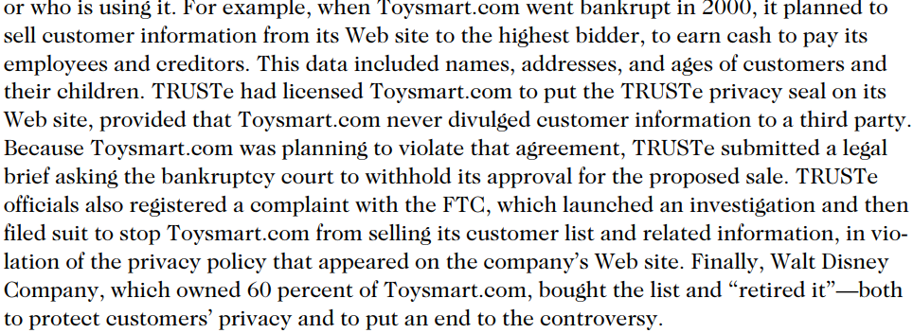
Consumer Profiling (cont’d.)
Opponents of consumer profiling
Whois using data
How it is being used
Ethics in Information Technology, Fourth Edition
Notes:
‹#›

Slide 48
Treating Consumer Data Responsibly
Strong measures are required to avoid customer relationship problems
Companies should adopt:
Fair Information Practices
Information carefully protected and shared
Consumers can review their own data
Company informs customer to use data for research – opt out
Companies establish corporate data policy
Ethics in Information Technology, Fourth Edition
Notes:
‹#›

Slide 49
Treating Consumer Data Responsibly
Chief privacy officer (CPO)
Executive to oversee data privacy policies and initiatives
Comply with governments laws and regulations
Must be authorized to stop/modify market initiative
Duties include
Training employees about privacy
Company privacy policy for risks
Figuring out gaps
Ethics in Information Technology, Fourth Edition
Notes:
‹#›

Slide 50
Treating Consumer Data Responsibly
Chief privacy officer (CPO)
Rationale-early involvement in such issues–less cost
For example, U.S. Bancorp, a bank with more than $250 billion in assets as of early 2009, appointed a CPO, but only after spending $3 million to settle a lawsuit that accused the bank of selling confidential customer financial information to telemarketers.
Ethics in Information Technology, Fourth Edition
Notes:
‹#›

Slide 51
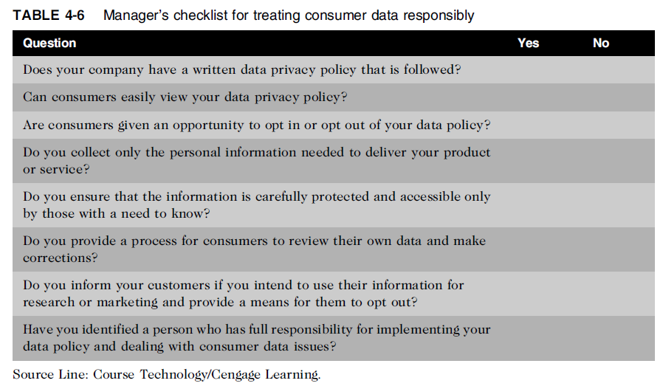
Treating Consumer Data Responsibly (cont’d.)
Ethics in Information Technology, Fourth Edition
Notes:
‹#›

Slide 52
Workplace Monitoring
Employers monitor workers
Protect against employee abuses that reduce worker productivity
Reasons for monitoring
Less productivity
Comply with legal liabilities of computer users
Ethics in Information Technology, Fourth Edition
Notes:
‹#›

Slide 53
Workplace Monitoring
Fourth Amendment cannot be used to limit how a private employer treats its employees
Public-sector employees have far greater privacy rights than in the private industry
Privacy advocates want federal legislation
To keep employers from infringing upon privacy rights of employees
Laws related to these continue to evolve
Ethics in Information Technology, Fourth Edition
Notes:
‹#›

Slide 54
Advanced Surveillance Technology
Camera surveillance
Many cities plan to expand surveillance systems
Advocates argue people have no expectation of privacy in a public place
Critics concerned about potential for abuse - accuracy
Global positioning system (GPS) chips
Placed in many devices
Precisely locate users
Banks, retailers, airlines eager to launch new services based on knowledge of consumer location
Ethics in Information Technology, Fourth Edition
Notes:
‹#›

Slide 55
Summary
Laws, technical solutions, and privacy policies are required to balance needs of business against rights of consumers
A number of laws have been enacted that affect a person’s privacy particularly in the areas of financial and health records, protection following a security breach, children’s personal data, electronic surveillance, export of personal data, and access to government records
Ethics in Information Technology, Fourth Edition
Notes:
‹#›

Slide 56
Summary (cont’d.)
Identity theft is fastest-growing form of fraud
E-discovery can be expensive, can reveal data of a private or personal data, and raises many ethical issues
Web sites collect personal data about visitors
Consumer data privacy has become a major marketing issue
Code of Fair Information Practices and 1980 OECD privacy guidelines provide an approach to treating consumer data responsibly
Ethics in Information Technology, Fourth Edition
Notes:
‹#›

Slide 57
Summary (cont’d.)
Employers monitor employees to maintain employee productivity and limit exposure to harassment lawsuits
Advances in information technology provide new data-gathering capabilities but also diminish individual privacy
Surveillance cameras
GPS systems
Ethics in Information Technology, Fourth Edition

